Slide 1
Genocide by inference:
An analysis of the inferred intention for genocide in the Karadžić trial judgement, currently pending on appeal

Slide 2
“Genocide is one of the worst crimes known to humankind, and its gravity is reflected in the stringest requirement of specific intent. Convictions for genocide can be entered only when they have been unequivocally established.”
Krstić Appeal Judgement, IT-98-33-A, 19 April 2004, para. 134.

Slide 3
Deronjić: there are 2000, and more are expected during the night.
Karadžić: all the goods must be placed inside the warehouses before twelve tomorrow… not in the warehouses over there, but somewhere else.

Slide 4
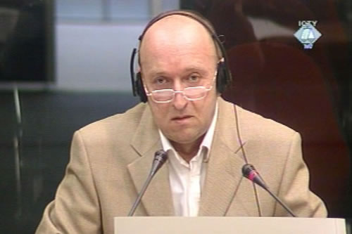
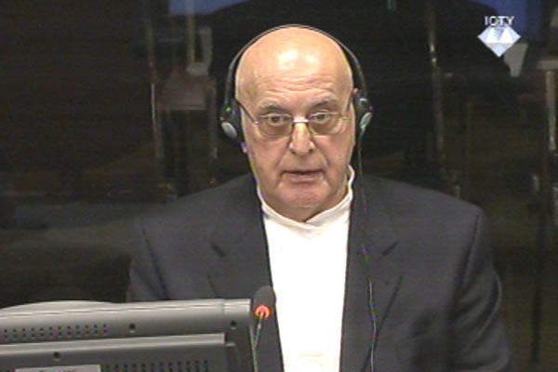
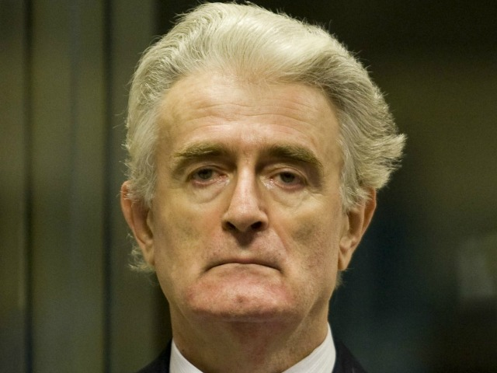
Deronjić →
Beara →
Karadžić said “Zvornik”

Slide 5
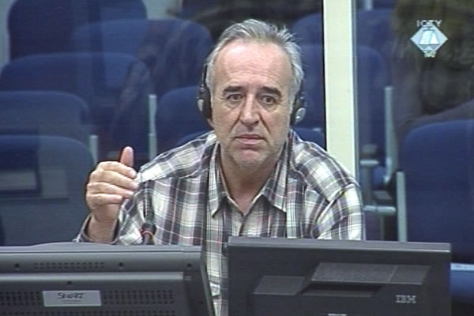

Slide 6
Genocide by inference:
An analysis of the inferred intention for genocide in the Karadžić trial judgement, currently pending on appeal

Slide 7
Karadžić Appeal Brief, 5 December 2016, Grounds 40-41.
Prosecution’s Response to Karadžić’s Appeal Brief, 15 March 2017, at paras. 446-455.
Karadžić Trial Judgement, para. 5798 onwards

