Slide 1
Colombian Special Jurisdiction for Peace
1. Amnesties are granted for political crimes (and crimes in connection with) as defined under domestic criminal law, including the act of rebellion and the killing according to IHL.
2. The crimes that cannot be legally amnestied, should be investigated and punished. These offenses include, genocide, crimes against humanity and war crimes.
3. The Special Jurisdiction prosecutes and sanctions state agents, former guerrilla members and third parties that directly or indirectly participated in the commission of international crimes. The system specifically targets those considered to be the most responsible of the most grave and representative crimes.
4. With respect to these crimes, a special set of sanctions, with a strong reparative dimension is available to those who fully disclose truth and acknowledge responsibility.
5. Participation in this accountability scheme is conditional. To receive reduced or restorative sanctions, defendants must comply with obligations related to truth, reparation and non-repetition.

Slide 2


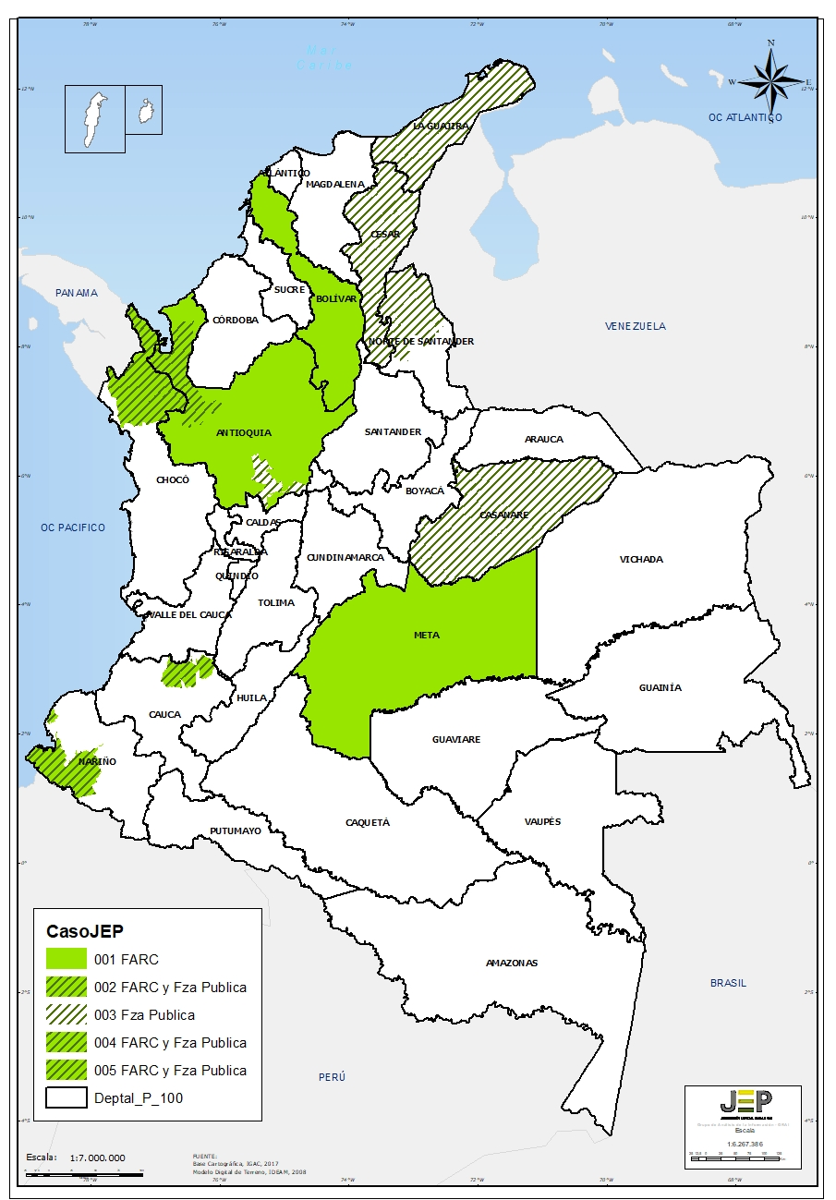
Caso 004
Case 004
Caso 003
Case 003
SITUATION IN URABA INVOLVING THE FARC-EP AND THE PUBLIC ARMED FORCES (1986-2016)
KILLINGS PRESENTED AS DEATHS IN COMBAT BY STATE AGENTS (“FALSE POSITIVES’)
787.000
Victims registered according to the Victims’ Unit
3.523
Registers related to facts contained in the Attorney General Office’s reports
174
Number of defendants allegedly implicated
Members of the Public Armed Forces involved allegedly implicated
12
Union and other collective subjects involved
Legal proceedings under study
10
Municipalities (4 indigenous communities and 8 black community councils)
Victims preliminary identified
Case 005
Victims Peasants (mostly from Cesar and Huila)
Caso 005
Provinces with the highest number of investigations
TERRITORIAL SITUATION IN THE NORTHERN CAUCA REGION – IT INCLUDES THE FACTS ALLEGEDLY COMMITTED BY MEMBERS OF THE FARC-EP AND THE PUBLIC FORCE (1993-2016)
Caso 001
Case 001
Caso 002
Case 002
ILLEGAL RETENTIONS OF PERSONS BY FARC-EP (1993 -2012)
SITUATION IN TUMACO, RICAURTE AND BARBACOAS INVOLVING THE FARC-EP AND THE PUBLIC ARMED FORCES (1990-2016)
Approximately, former guerrilla combatants involved
Situations of victimization
Convictions against members of the FARC-EP’s leadership under study
Victims identified by their first and last names
Former FARC combatants allegedly implicated
Victims preliminary identified
Provinces with the highest number of criminal investigations for illegal retentions of persons by FACR-EP*
Members of the Public Armed Forces allegedly implicated
Community counsels
* Illegal retention of persons is a phenomenon that comprises all of the national territory
Indigenous reservations

