Slide 1
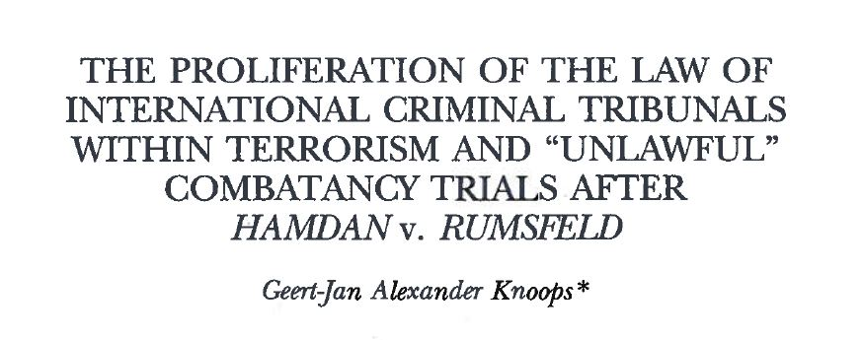
* Fordham International Law Journal (April 2007), [Vol. 30:1301].

Slide 2

Content
US SC judgement 29 June 2006: three major issues
History of the case
Charges
Legal challenges
Conspiracy as triable offense to try violations LOAC
The Hamdan Defense approach re conspiracy
Arguments ‘Opinion Brief’ Defense Hamdan
US government’s argument opposing the Defense
Projection from the Hamdan (defense) case

Slide 3
US SC judgment 29 June 2006: three major issues
Legality of terrorism trials before military commission.
Direct effect Third Geneva Convention.
Conspiracy as a form of criminality or triable offense within ICL.

Slide 4
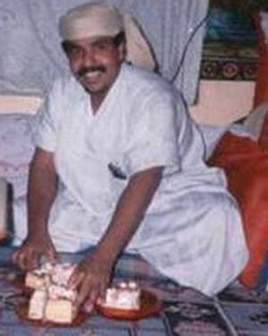
History of the case
Salim Ahmed Hamdan, Yemeni descent.
Arrested by militia in November 2001.
Handed over to US military.
June 2002: transferred to Gitmo.
2003: President Bush determined that Hamdan should stand trial before MC.

Slide 5
Charges
Conspiracy to commit “attacking civilians (objects), murder by an unprivileged belligerent and terrorism”.
Hamdan had served as Osama Bin Laden’s body guard/personal driver 1996 – November 2001.
CSRT: Hamdan is ‘enemy combatant’.

Slide 6
Legal challenges
Hamdan challenged lawfulness MC and charges (conspiracy: not violation LOAC).
Petitioned to Federal Courts on habeas corpus relief.
District Court District Columbia (2004): ruled in Hamdan’s favor.
2005: Court of Appeals: reversed decision.

Slide 7
Conspiracy as triable offense to try violations LOAC
Four Justices US SC: not a triable offense.
First argument: alleged acts Hamdan not committed “within the theatre of war”.
  Requirement: offenses must be committed during the AC, not before or after.
  Neither the alleged agreement with OBL to commit war crimes, nor a single overt act occurred in a theatre of war or on any date after September 11, 2001.

Slide 8
Conspiracy: no triable offense violations LOAC: Second argument
An undefined offense, at least be: “plain and unambiguous”; not met.
International jurisprudence confirms: conspiracy is not a recognized violation of the LOAC.
ICT’s only recognized conspiracy: conspiracy to commit genocide/common plan to wage aggressive war.

Slide 9
The Hamdan Defense approach re conspiracy
The majority of the US SC followed the defense approach relying on ICTY case law.
Legal Opinion on Joint Criminal Enterprise (JCE) and Conspiracy February 23, 2006: conspiracy not a triable offense before MC.
Legal Opinion (‘Opinion Brief’) analyzed ICTY case law re conspiracy.
Particular: Dragoljub Ojdanić Motion Challenging Jurisdiction – Joint Criminal Enterprise, AC 21 May 2003, paras 23 and 26.
Ojdanić: JCE and ‘conspiracy’ are two distinct forms of liability; mere membership in a JCE would not culminate into liability for crimes commited by that JCE.

Slide 10
Arguments ‘Opinion Brief’ Defense Hamdan
First Argument: historical analysis travaux préparatoires; no application of conspiracy in the WWII convictions.
  Only accepted re crimes of aggression and crimes against peace; not in regard to war crimes/crimes against humanity.
  Influence French judge Henri Donnedieu de Vabres: concept unknown in international law.

Slide 11
Arguments ‘Opinion Brief’ Defense Hamdan
Second Argument
  Evaluation ICTY Statute
  Art. VI Statute: jurisdiction over ‘natural persons’
  Possibility extending ICTY personal jurisdiction to organizations for purpose of establishing membership therein: discarded.
  Guilt by mere association does not comport with ICTY principle that criminal liability is personal.

Slide 12
US government’s argument opposing the Defense
Reliance on Art. 25(3)(d) ICC Statute (group of persons acting with common purpose)
Defense Hamdan:
  Art. 25(3)(d) differs from conspiracy MC act.
  Accused must ‘contribute’; merely being a member does not suffice (ensuring safety Osama Bin Laden is not ‘contributing’).
  Requirement of ‘intentionally’: personal knowledge of specific crime under ICC Statute.
  JCE third category not included in ICC Statute
  Art. 22(2) ICC Statute: any ambiguity should be interpreted in favour of the accused.

Slide 13
Projection from the Hamdan (defense) case
Majority US SC accepted that jurisdiction MC does not encompass conspiracy.
MC lacked authority to try Hamdan.
In fact: SC transformed a substantive deficiency into a jurisdictional one.
Introduction of ‘military necessity’: charges contained procedural defects and were indicative of a broader failure of US government to comply with international law.

